Slide 1
DEVELOPER TRAINING
RabbitMQ &
MassTransit
Deep Dive
Message Brokers · Event-Driven Architecture · .NET Integration
2026

Slide 2
Agenda
What is MassTransit? RabbitMQ Overview & Architecture Messages & Contracts Producers & Consumers RabbitMQ Topology Message Patterns (Send / Publish / Request-Response) Reliability: Retries, Redelivery & Outbox Sagas & State Machines Configuration & Setup Best Practices

Slide 3
What is MassTransit?
Distributed application framework for .NET Abstracts message broker complexity — RabbitMQ, Azure Service Bus, Amazon SQS, ActiveMQ, SQL Defines a consistent programming model across transports More than an abstraction — it defines operational patterns: Retries & delayed redelivery Outbox for at-least-once delivery Scheduling, workflows, unit test harness Battle-tested: 15+ years, most popular .NET messaging framework v9 (Massient): commercial product with full support

Slide 4
RabbitMQ Overview
Open-source message broker implementing AMQP Lightweight — runs on-premises or in the cloud High availability: distributed & federated configurations Key features: Exchanges — routing agents directing messages to queues Queues — durable storage for incoming messages Bindings — rules linking exchanges to queues Plugins — management UI, delayed exchange, federation Management UI at http://localhost:15672 (guest / guest) MassTransit fully supports RabbitMQ including advanced features

Slide 5
Messages & Contracts
A message is a contract — defined as a .NET class or interface Contracts define stable ports between services; implementations evolve independently Two primary message types: Commands — tell a service to do something (verb-noun: SubmitOrder, ProcessPayment) → sent to a specific endpoint (queue) Events — signal that something happened (OrderSubmitted, PaymentProcessed) → published to all interested consumers Keep message contracts in a shared assembly for consistency Messages are serialized (JSON by default) and routed by MassTransit

Slide 6
Producers & Consumers
Producer
Sends or publishes messages via IBus or IPublishEndpoint
await bus.Publish<OrderSubmitted>(new { });
await endpoint.Send<SubmitOrder>(new { });
Decoupled from consumers — does not know who handles the message
Messages are buffered before sending for higher throughput
Consumer
Implements IConsumer<TMessage>
public class OrderConsumer
: IConsumer<SubmitOrder>
{
public async Task Consume(
ConsumeContext<SubmitOrder> ctx)
{ // handle message }
}
Registered via AddConsumer<T>()
MassTransit handles concurrency, retries, and error routing

Slide 7
Publish vs Send
Publish
Broadcast to all subscribers of the message type
Uses a fanout exchange in RabbitMQ — zero or more consumers receive it
No destination required — MassTransit routes automatically
// via IBus or IPublishEndpoint
await bus.Publish<OrderPlaced>(
new { OrderId = id });
Use for events — something that happened
Send
Targets a specific endpoint (queue address)
Routes to a single known consumer queue — direct exchange
Caller must know the destination URI
var ep = await bus.GetSendEndpoint(
new Uri("queue:order-service"));
await ep.Send<SubmitOrder>(
new { OrderId = id });
Use for commands — a request to do something

Slide 8
When to Use Publish vs Send
Publish — use when you are raising an event (something that already happened)
OrderPlaced, PaymentProcessed, StockReserved
Multiple services can react independently; sender is fully decoupled
If no consumer is subscribed, the message is silently dropped
Send — use when you are issuing a command (an instruction to do something)
SubmitOrder, CancelReservation, SendConfirmationEmail
Exactly one consumer handles it; sender knows the target queue
Fails if the queue does not exist — routing is explicit, not automatic
Rule of thumb: name events in past tense, commands in imperative

Slide 9
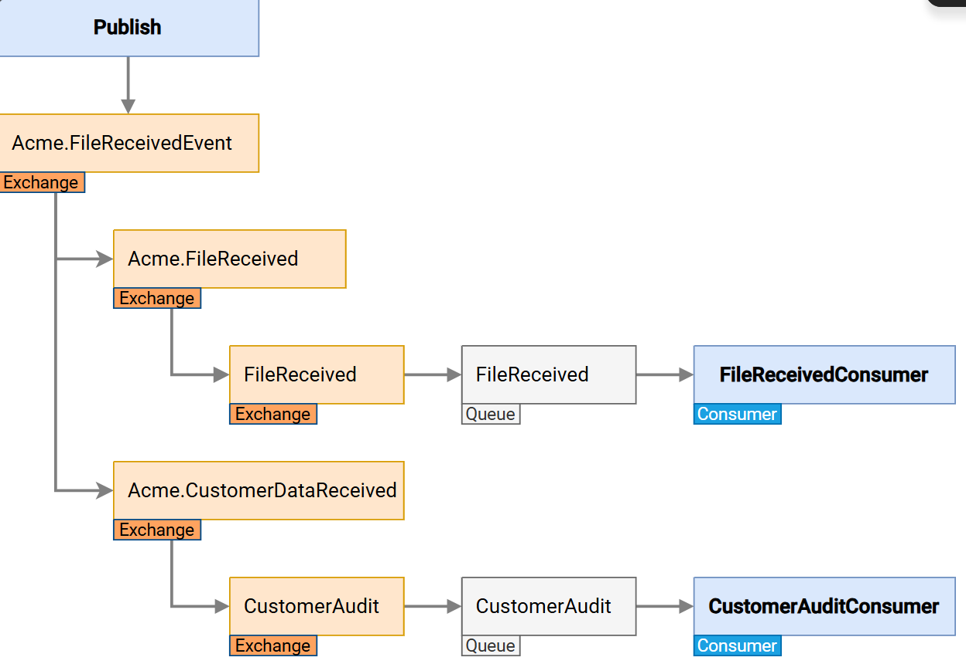

Slide 11
PUBLISH — Event (fan-out)
bus.Publish<OrderPlaced>(evt)
How it works
1. MassTransit creates a fanout exchange
named after the message type
2. RabbitMQ delivers a copy to every
queue bound to that exchange
3. Each consumer reads from its own queue
independently — fully decoupled
4. Zero subscribers: message dropped
silently — no exception thrown
Use for: events (past-tense names)
OrderPlaced, UserRegistered
Exchange (Topic / Fan-out)
Queue A
Queue B
Queue C
Consumer 1
Consumer 2
Consumer 3
ALL consumers receive a copy

Slide 12
SEND — Command (point-to-point)
bus.Send<ProcessOrder>(cmd)
How it works
1. Sender specifies an endpoint address
(queue name or URI)
2. Message routed to that exact queue
via a direct exchange
3. Exactly ONE consumer processes it
4. If queue missing → exception thrown
Use for: commands (imperative names)
ProcessOrder, SendInvoice
Key difference vs Publish:
• Must have a registered consumer
• Throws if endpoint not found
• One message = one handler
Direct Exchange (named queue)
Queue: order-processor
Consumer (ONE instance)
EXACTLY ONE consumer receives it

Slide 13
Competing Consumers — Scale-out
bus.Publish<OrderPlaced>(evt)
How it works
1. All instances subscribe to same queue
2. RabbitMQ delivers each message once
3. First consumer to pull gets the msg
4. Others never see that message
Why this matters for scaling
• 3 instances = 3x message throughput
• No duplicates, no coordination needed
• MassTransit sets this up automatically
vs Publish fan-out:
• Fan-out: ALL consumers get a copy
• Competing: ONE consumer gets it
Horizontal scale = add more instances
Exchange (Fan-out)
Shared Queue (order-processor)
Consumer 1
Consumer 2
Consumer 3
ONLY ONE consumer processes each msg

Slide 14
Request / Response Pattern
MassTransit — IRequestClient<T>
What is it?
How it flows
A messaging pattern where one service sends a request to another and waits for a response — like a function call, but over the network. MassTransit creates a temporary reply queue automatically. The caller simply awaits a Task.
① Requester: IRequestClient.GetResponse()
② MassTransit routes to consumer queue
Benefits
Watch out for
③ Consumer: context.RespondAsync(result)
✔ Loose coupling ✔ Location transparency ✔ Async / await friendly ✔ Auto Fault<T> on error
⚠ Added network latency ⚠ Timeout if bus not started ⚠ Default timeout: 30 s ⚠ Avoid for fire-and-forget
④ Requester awaits response Task
⟳ Temporary reply queue auto-created by MassTransit

Slide 15
Using IRequestClient<T>
C#
Key Points
// 1. Message contracts public record CheckOrderStatus(Guid OrderId); public record OrderStatusResult(Guid OrderId, string Status); // 2. Register (Program.cs) builder.Services.AddMassTransit(x => { x.AddConsumer<CheckOrderStatusConsumer>(); x.UsingRabbitMq((ctx, cfg) => cfg.ConfigureEndpoints(ctx)); }); // 3. Inject & use request client public class OrderController(IRequestClient<CheckOrderStatus> client) { public async Task<IActionResult> GetStatus(Guid id) { var response = await client.GetResponse<OrderStatusResult>( new CheckOrderStatus(id)); return Ok(response.Message.Status); } } // 4. Consumer — respond to the request public class CheckOrderStatusConsumer : IConsumer<CheckOrderStatus> { public async Task Consume(ConsumeContext<CheckOrderStatus> ctx) { var status = LookUpStatus(ctx.Message.OrderId); await ctx.RespondAsync( new OrderStatusResult(ctx.Message.OrderId, status)); } }
📨
Message Contracts
Define request & response as plain C# records or interfaces
⚙️
Auto-wired
AddMassTransit registers IRequestClient<T> automatically — just inject it
⏱
Timeout
Default 30s. Use RequestTimeout.After(s:10) to customize
❌
Fault handling
On exception → Fault<T> sent back; client throws RequestFaultException
✉️
Multiple responses
GetResponse<T1, T2>() supports awaiting two response types at once

Slide 16
RPC over RabbitMQ — Request/Response Flow
Client
RabbitMQ
Server
Publish to "rpc_queue"
ReplyTo = "amq.gen-xxx"
CorrelationId = "abc-123"
Deliver to consumer
(processes request…)
Publish to "amq.gen-xxx"
CorrelationId = "abc-123"
Deliver response
Client
RabbitMQ
Server

Slide 17
The Full Picture — Under the Hood
Good question. It has nothing to do with HTTP — here's the actual flow.
PUBLISHER
RABBITMQ
CONSUMER
host.StartAsync()
creates temp reply queue
reply-queue-abc123 [auto-delete]
client.GetResponse<...>(request)
publishes to →
[get-order-status]
Consume(context)
reads OrderId
ReplyAddress = "reply-queue-abc123"
does work…
CorrelationId = "some-guid-1234"
context.RespondAsync(...)
reply-queue-abc123
publishes to ReplyAddress →
(same CorrelationId)
await GetResponse<...> resolves
listening on reply queue…
matched by CorrelationId
returns Response<T> ✔
Two one-way queue messages → looks like a synchronous await from the caller's perspective

Slide 18
Mapped to Your Code
What each line actually does inside MassTransit
Consumer side — GetOrderStatusConsumer.cs:8
Publisher side — Publisher/Program.cs:32
// MT registered a queue named "get-order-status" via ConfigureEndpoints()
// It listens on that queue permanently
public async Task Consume(
ConsumeContext<GetOrderStatusRequest> context)
{
// context.Message → deserialized request body
// context.CorrelationId → GUID publisher awaits
// context.ReplyAddress → "rabbitmq://localhost/reply-queue-abc123"
await context.RespondAsync(new GetOrderStatusResponse { ... });
// ↑ MT reads ReplyAddress and publishes response there
// with same CorrelationId so publisher can match it
}
// NOT a blocking thread — registers a TaskCompletionSource
// keyed on CorrelationId, then awaits it
var response = await client.GetResponse<GetOrderStatusResponse>(
new GetOrderStatusRequest { OrderId = orderId });
// Resumes only when a message arrives on the reply queue
// with a matching CorrelationId
// Access the response:
var status = response.Message.Status;
var corrId = response.CorrelationId; // matches what was sent
① MT auto-creates queue on startup
② context carries all routing info
③ RespondAsync uses ReplyAddress + CorrelationId
① GetResponse publishes + registers TCS on CorrelationId
② Task unblocks only when matching reply arrives
③ response.Message is the fully deserialized T
Key insight
GetResponse is asynchronous — it registers a TaskCompletionSource keyed on CorrelationId, not a blocking thread.
Timeout config:
services.AddMassTransit(x => x.AddRequestClient<GetOrderStatusRequest>(timeout: RequestTimeout.After(s: 10)));
// None = wait forever (not recommended) | Default = 30s | RequestTimeout.After(...) = custom

Slide 19
What's in RabbitMQ
Open http://localhost:15672 during a run — here's what you'd see
RabbitMQ Management UI → http://localhost:15672 (guest / guest)
Queue
Created by
Auto-delete
get-order-status
Consumer on startup via
No — persists permanently
ConfigureEndpoints()
→ registered automatically from consumer class
reply-queue-abc123…
Publisher on host.StartAsync()
Yes — deleted on disconnect
(unique per publisher instance)
→ MT creates before first request
→ exclusive to this publisher process

Slide 20
Key Differences — HTTP vs MassTransit Request/Response
Same end-result from the caller's view — very different mechanics underneath
HTTP
MassTransit Request/Response
Protocol
TCP + HTTP (port 80/443)
TCP + AMQP (port 5672)
Coupling
Publisher must know Consumer's URL
Publisher only knows the message type
Broker
No broker — direct connection
Yes — RabbitMQ buffers the request
Consumer offline
Request fails immediately
Message stays in queue until Consumer comes up
Correlation
Implicit — same socket/connection
Explicit GUID in message header
Reply address
HTTP response on same socket
Separate temporary reply queue
Core idea
MassTransit turns two one-way queue messages (request → consumer queue, response → reply queue)
into something that looks like a synchronous await from the caller's perspective.

Slide 21
Reliability: Retries, Redelivery & Outbox
Retries
Immediate retry on transient failures — UseMessageRetry(r => r.Interval(3, 5000))
Delayed Redelivery
Re-queues after delay (needs RabbitMQ delayed exchange plugin) — UseScheduledRedelivery(...)
Outbox Pattern
Prevents messages publishing before saga state persists
Buffers published messages; dispatches after successful persistence
Eliminates race conditions in saga workflows
Fault Queues
Failed messages move to <queue>_error after exhausting retries; Fault<T> event published

Slide 22
Saga Pattern
Managing distributed transactions across microservices without a global lock
Two main approaches:
Choreography — services react to events autonomously; no central controller
Orchestration — a central Saga orchestrator directs each step explicitly
Each step publishes compensating transactions on failure to maintain eventual consistency

Slide 23
Saga: Choreography
Order Service
Payment Service
Inventory Service
Shipping Service
OrderCreated
PaymentProcessed
InventoryReserved
ShippingCompleted
✔ Pros
No central coordinator — loosely coupled
Add services by subscribing to events
No single point of failure
Natural fit for event-driven architecture
✘ Cons
Hard to track overall transaction state
Business logic scattered — hard to debug
Cyclic dependency risk between services
Compensating transactions still required

Slide 24
Saga: Orchestration
Saga Orchestrator
(StateMachine)
Order Service
Payment Service
Inventory Service
Shipping Service
✔ Pros
Centralized control — easy to track state
Clear business flow in one place
Easier debugging — audit trail in state machine
MassTransit StateMachine built-in support
✘ Cons
Orchestrator is a single point of failure
Tighter coupling — services know orchestrator
More complex initial setup
Risk of orchestrator becoming a bottleneck

Slide 25
Sagas & State Machines
Sagas manage long-running, multi-step distributed processes Each saga instance is identified by a unique CorrelationId (Guid) Two styles: Consumer Saga — class implements ISaga + handler interfaces State Machine Saga — class derives from MassTransitStateMachine<T> State machine components: States — conditions (Initial, Submitted, Processing, Final) Events — messages that trigger transitions Behaviors — actions executed on event receipt Saga persistence: In-Memory (dev), EF Core, MongoDB, Redis, Marten Outbox is strongly recommended for sagas to avoid concurrency issues Built-in: fault tolerance, state visibility, loose coupling, maintainability

Slide 26
Saga Example: Order Flow
SubmitOrder
ReserveInventory
ProcessPayment
CreateShipment
Shipped ✓
ShipmentFailed
RefundPayment
ReleaseInventory
Failed ✗
MassTransit StateMachine (C#)
public class OrderStateMachine :
MassTransitStateMachine<OrderState>
{
// States
public State Reserved;
public State PaymentProcessed;
public State Compensating;
public State Failed;
// Events
public Event<SubmitOrder> SubmitOrder;
public Event<InventoryReserved> Inventory;
public Event<PaymentProcessed> Payment;
public Event<ShipmentFailed> ShipFailed;
public Event<PaymentRefunded> Refunded;
public Event<InventoryReleased> Released;
During(Initial,
When(SubmitOrder)
.Publish(ctx => new ReserveInventory(...))
.TransitionTo(Reserved));
During(Reserved,
When(InventoryReserved)
.Publish(ctx => new ProcessPayment(...))
.TransitionTo(PaymentProcessed));
During(PaymentProcessed,
When(ShipmentFailed)
.Publish(ctx => new RefundPayment(...))
.TransitionTo(Compensating));
During(Compensating,
When(PaymentRefunded)
.Publish(ctx => new ReleaseInventory(...)),
When(InventoryReleased)
.TransitionTo(Failed)
.Finalize());
}

Slide 27
Outbox Pattern — Fixing Saga Crash Consistency
Problem — Without Outbox
Solution — With Outbox
1. Receive InventoryReserved
BEGIN TRANSACTION
UPDATE order_states
CurrentState = 'WaitingForPayment'
2. UPDATE DB
CurrentState = WaitingForPayment ✓
INSERT INTO outbox_messages
payload = RequestPayment
3. ✷ CRASH ✷
COMMIT ✓ (atomic — both or neither)
4. Publish(RequestPayment)
✗ NEVER EXECUTES
Outbox Dispatcher (on restart):
─── SagaHost restarts ───
Read pending outbox rows
5. RabbitMQ redelivers InventoryReserved
Publish RequestPayment → RabbitMQ
Delete from outbox
6. DB = WaitingForPayment
During(Submitted,..) → NO MATCH
DB state + message in sync ✅
7. Message dropped
Order stuck forever 🔴
❌ Crash before publish:
DB committed, message never sent
State = WaitingForPayment but
no payment requested → stuck forever
✅ Outbox atomicity guarantee:
Crash before COMMIT → nothing happens
Crash after COMMIT → dispatcher sends
Crash during send → retry from outbox

Slide 28
State Machine Example: Order Flow
public class OrderStateMachine : MassTransitStateMachine<OrderState>
{
public State Submitted { get; private set; }
public Event<OrderSubmitted> OrderSubmitted { get; private set; }
public Event<PaymentProcessed> PaymentProcessed { get; private set; }
public OrderStateMachine() {
Event(() => OrderSubmitted, x => x.CorrelateById(m => m.Message.OrderId));
Initially(When(OrderSubmitted).TransitionTo(Submitted));
During(Submitted,
When(PaymentProcessed).TransitionTo(Processing),
When(OrderFailed).Finalize()); }
}

Slide 29
Configuration & Setup
// 1. Install NuGet packages
dotnet add package MassTransit.RabbitMQ
// 2. Register in Program.cs
builder.Services.AddMassTransit(x =>
{
x.AddConsumer<OrderSubmittedConsumer>();
x.AddSagaStateMachine<OrderStateMachine, OrderState>()
.InMemoryRepository();
x.UsingRabbitMq((ctx, cfg) =>
{
cfg.Host("localhost", "/", h => { h.Username("guest"); h.Password("guest"); });
cfg.UseMessageRetry(r => r.Interval(3, 5000));
cfg.UseInMemoryOutbox(); cfg.ConfigureEndpoints(ctx);
});
});
// Docker: docker run -p 15672:15672 -p 5672:5672 masstransit/rabbitmq

Slide 30
Best Practices
Isolate message contracts in a shared assembly — ensures publisher/consumer consistency Register MassTransit as a singleton — prevents duplicate RabbitMQ connections Design thoughtful exchange/queue topology — avoid routing everything to one queue Implement dead-letter queues — gracefully handle poison messages Use durable queues and publish confirmations — enhance reliability Use Outbox for sagas — prevents concurrency and lost-message issues Always set CorrelationId as the primary key on saga tables — optimizes performance Start listeners before publishing events — or use durable queues from day one Prefer ConfigureEndpoints() — auto-discovers consumers, sagas, and activities Use the built-in test harness for unit testing consumers and state machines

Slide 31
MASSTRANSIT SETUP
Using NuGet to
Bootstrap
MassTransit
One package install · No manual copying · Consistent across all projects
2026

Slide 32
AGENDA
What We'll Cover Today
01
02
03
What is NuGet?
Local NuGet Repository
GitHub Packages
Package manager for .NET, repository types & concepts
Create and register a local package feed
Host NuGet packages directly on GitHub
04
05
06
Create a .NET Library
Build & Pack
Publish to GitHub
Class library, project metadata & target frameworks
dotnet pack, versioning & .nupkg inspection
Authenticate, push & verify your package

Slide 33
01 · NUGET
What is NuGet?
NuGet is the official package manager for .NET. It enables developers to create, share, and consume reusable code libraries — similar to npm for Node.js or pip for Python.
300K+
Packages on nuget.org
Package Format:
.nupkg file containing compiled DLLs, XML docs & metadata
2012
Dependency Management:
Automatically resolves and downloads transitive dependencies
Year NuGet was released
Multiple Sources:
nuget.org (public), GitHub Packages, Azure Artifacts, or local feed
.nupkg
.NET Toolchain:
Built into dotnet CLI, Visual Studio, MSBuild, and Rider
Package file format

Slide 34
02 · LOCAL FEED
How to Create a Local NuGet Repository
1
Create a local folder
When to use a Local Feed?
mkdir C:\LocalNuGet
Testing a package before publishing
No internet / air-gapped environments
Sharing packages within a small dev team
CI/CD pipeline build artifacts
Inner-loop development & prototyping
Offline NuGet restore scenarios
2
Register it as NuGet source
dotnet nuget add source C:\LocalNuGet --name "LocalFeed"
3
Verify registered sources
dotnet nuget list source
4
Copy .nupkg into the folder
# Place your .nupkg file inside C:\LocalNuGet
5
Install package from feed
dotnet add package MyLibrary --source "LocalFeed"
💡 NuGet.Config lives at %AppData%\NuGet\NuGet.Config (global) or per-solution nuget.config

Slide 35
03 · GITHUB PACKAGES
What are GitHub Packages?
A package hosting service fully integrated into your GitHub repository
Multiple Package Types
Access Control
Supports NuGet, npm, Maven, RubyGems, Docker images and more
Tied to GitHub repo permissions — private or public, same model as your code
Close to Source
GitHub Actions Ready
Package lives next to the repo — same org, same permissions, same workflow
Publish directly from CI/CD pipeline using the built-in GITHUB_TOKEN
Free for Public Repos
Registry URL Format
Free unlimited storage & bandwidth for public repos; quota for private
https://nuget.pkg.github.com/{OWNER}/index.json

Slide 36
03 · SETUP
Setting Up GitHub Packages for NuGet
Step 1 — Create a Personal Access Token (PAT)
Step 2 — Add GitHub as NuGet Source
1. GitHub → Settings → Developer settings
2. Personal access tokens → Tokens (classic)
3. Generate new token → select scopes:
write:packages read:packages delete:packages
4. Copy and store your token securely!
dotnet nuget add source \
https://nuget.pkg.github.com/OWNER/index.json \
--name "github" \
--username YOUR_GITHUB_USERNAME \
--password YOUR_PAT_TOKEN
Recommended for teams — use nuget.config file:
<?xml version="1.0" encoding="utf-8"?>
<configuration>
<packageSources>
<add key="github"
value="https://nuget.pkg.github.com/OWNER/index.json" />
</packageSources>
<packageSourceCredentials>
<github>
<add key="Username" value="GITHUB_USERNAME" />
<add key="ClearTextPassword" value="%GITHUB_TOKEN%" />
</github>
</packageSourceCredentials>
</configuration>
⚠️ Never commit PAT tokens to source control — use environment variables or GitHub Secrets instead.

Slide 37
04 · CREATE LIBRARY
Creating a .NET Class Library
Step-by-Step Commands
Project Structure
# 1. Create the class library project
dotnet new classlib -n MyAwesomeLib -f net10.0
# 2. Enter the project directory
cd MyAwesomeLib
# 3. (Recommended) Create a solution
dotnet new sln -n MyAwesomeLib
dotnet sln add MyAwesomeLib.csproj
# 4. Build to verify
dotnet build --configuration Release
MyAwesomeLib/
├── MyAwesomeLib.sln
└── MyAwesomeLib/
├── MyAwesomeLib.csproj
├── Class1.cs
└── bin/
└── Release/
└── net8.0/
├── MyAwesomeLib.dll
└── MyAwesomeLib.xml
Choosing the Right Target Framework:
net10.0
→ .NET 8 LTS — best for new projects; modern APIs

Slide 38
04 · METADATA
Configuring Package Metadata in .csproj
MyAwesomeLib/MyAwesomeLib.csproj
Property Reference
req
PackageId
<Project Sdk="Microsoft.NET.Sdk">
<PropertyGroup>
<TargetFramework>net8.0</TargetFramework>
<!-- Package Identity -->
<PackageId>MyAwesomeLib</PackageId>
<Version>1.0.0</Version>
<Authors>Binh Nguyen</Authors>
<Company>Innova SW</Company>
<!-- Package Details -->
<Description>A reusable utility library for .NET apps</Description>
<PackageTags>utilities;helpers;innova</PackageTags>
<PackageReadmeFile>README.md</PackageReadmeFile>
<!-- Source & License -->
<RepositoryUrl>https://github.com/OWNER/REPO</RepositoryUrl>
<PackageLicenseExpression>MIT</PackageLicenseExpression>
<GeneratePackageOnBuild>false</GeneratePackageOnBuild>
</PropertyGroup>
</Project>
Unique identifier on the registry
req
Version
SemVer: MAJOR.MINOR.PATCH
Authors
Comma-separated author names
Company
Organisation / company name
Description
Shown in NuGet browser and IDE
PackageTags
Semicolon-separated search keywords
RepositoryUrl
Link back to source code on GitHub
PackageLicenseExpression
SPDX identifier, e.g. MIT, Apache-2.0

Slide 39
04 · VERSIONING
Library Versioning — Semantic Versioning (SemVer)
1
.
2
.
3
MAJOR
MINOR
PATCH
MAJOR:
Breaking changes — API is not backwards compatible with previous version
MINOR:
New features — backwards compatible additions, no existing APIs removed
PATCH:
Bug fixes only — backwards compatible fixes with no new functionality
Pre-release:
1.0.0-alpha · 1.0.0-beta.1 · 1.0.0-rc.2 | Set via <Version> tag or: dotnet pack --version-suffix beta

Slide 40
05 · BUILD & PACK
Building the NuGet Package
1. Build in Release mode
What's inside a .nupkg?
dotnet build --configuration Release
MyAwesomeLib.1.0.0.nupkg
(it's a ZIP file!)
├── MyAwesomeLib.nuspec
│ └─ package metadata
├── lib/
│ └── net8.0/
│ ├── MyAwesomeLib.dll
│ └── MyAwesomeLib.xml
├── [Content_Types].xml
└── _rels/.rels
2. Create the NuGet package
dotnet pack --configuration Release
# → bin/Release/MyAwesomeLib.1.0.0.nupkg
3. Pack with version override
dotnet pack -p:Version=2.0.0 --configuration Release
4. Combine in one command
💡 Rename .nupkg → .zip to inspect it with any archive tool.
dotnet build && dotnet pack -c Release -o ./artifacts

Slide 41
06 · PUBLISH
Publishing to GitHub Packages
Option A — Push via dotnet CLI
Option B — GitHub Actions (CI/CD)
dotnet nuget push \
bin/Release/MyAwesomeLib.1.0.0.nupkg \
--source "github" \
--api-key YOUR_PAT_TOKEN
# Wildcard — push all packages:
dotnet nuget push bin/Release/*.nupkg \
--source "github" \
--api-key $GITHUB_TOKEN
name: Publish to GitHub Packages
on:
push: { tags: ['v*.*.*'] }
jobs:
publish:
runs-on: ubuntu-latest
steps:
- uses: actions/checkout@v4
- run: dotnet pack -c Release
- run: dotnet nuget push \
**/*.nupkg --source github \
--api-key ${{secrets.GITHUB_TOKEN}}
Build
Pack
Authenticate
Push
Verify on GitHub
✅ After pushing, navigate to your GitHub repo → click the Packages tab to see your published package

Slide 42
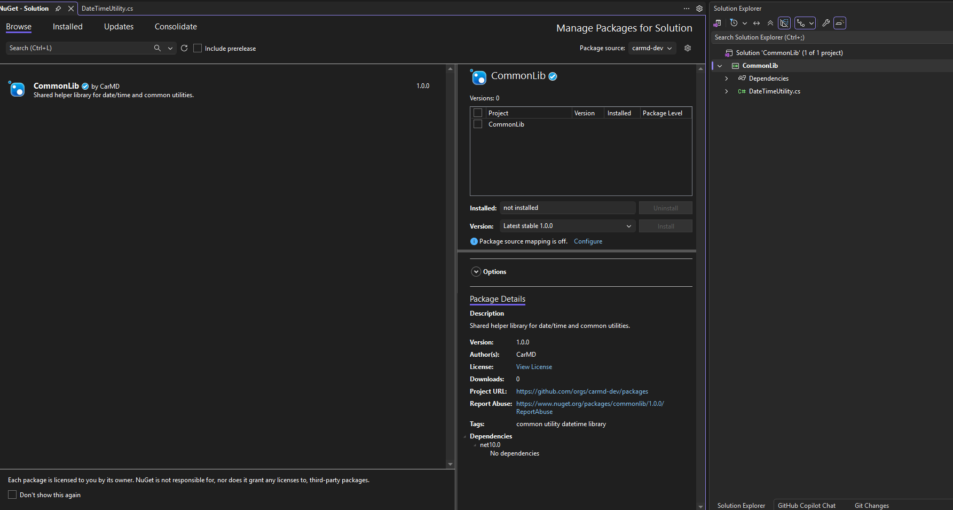

Slide 43
End-to-End Workflow
From code to published package — step by step
1
2
3
4
5
6
Create Library
Write & Test Code
Edit Metadata
Build & Pack
Authenticate
Push Package
dotnet new classlib
Write your public API
PackageId, Version, Authors
dotnet pack -c Release
Add source + PAT token
dotnet nuget push
Package consumers install with:
dotnet add package MyAwesomeLib --source "github"
<PackageReference Include="MyAwesomeLib" Version="1.0.0" />

Slide 44
BEST PRACTICES
Best Practices & Key Takeaways
Versioning
Security
Always follow Semantic Versioning (SemVer)
Never commit PAT tokens to source control
Bump MAJOR for any breaking API change
Use environment variables or GitHub Secrets
Use pre-release tags (alpha/beta/rc) for staging
Rotate tokens regularly and limit scopes
Quality
CI / CD
Add XML doc comments to all public APIs
Automate publishing with GitHub Actions
Include a README.md in your package
Trigger publish only on version tags (v*.*.*)
Write unit tests before publishing stable versions
Use GITHUB_TOKEN where possible — no PAT needed

Slide 45
Key Takeaways
MassTransit = consistent .NET messaging API across brokers
RabbitMQ = exchanges + queues + exchange-to-exchange bindings
Commands target queues — Events fan out to all subscribers
Reliability: Retries + Redelivery + Outbox + Fault Queues
Sagas: Long-running workflows via explicit state machines

